Slide 1

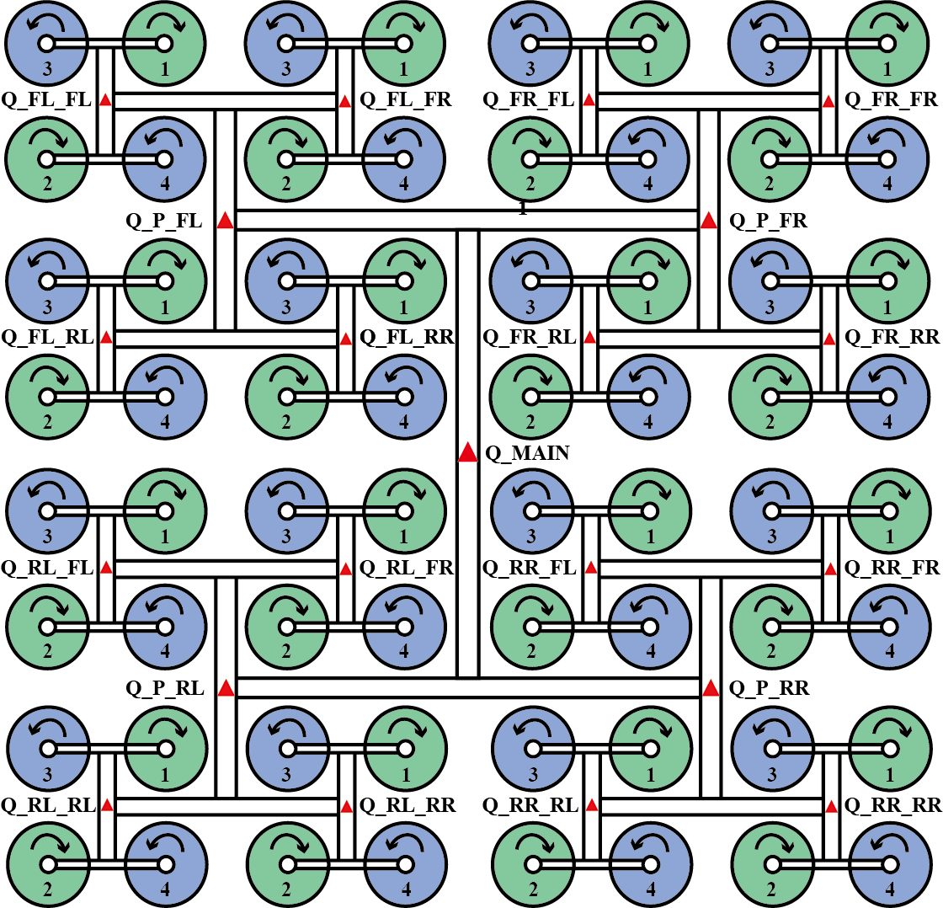
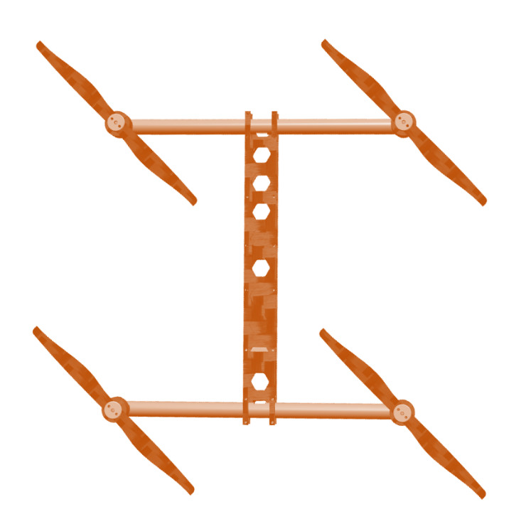
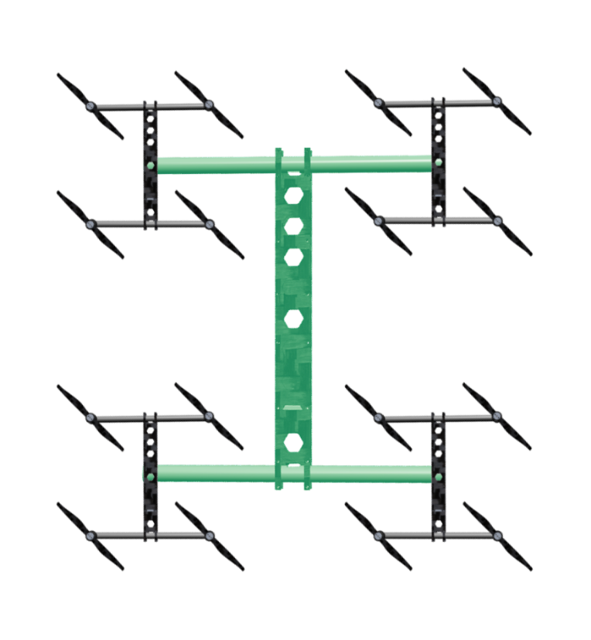
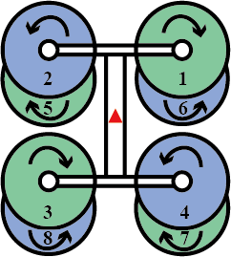
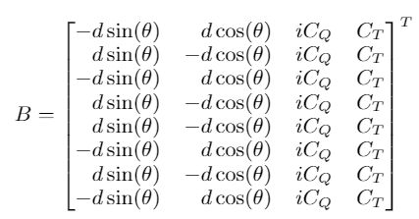
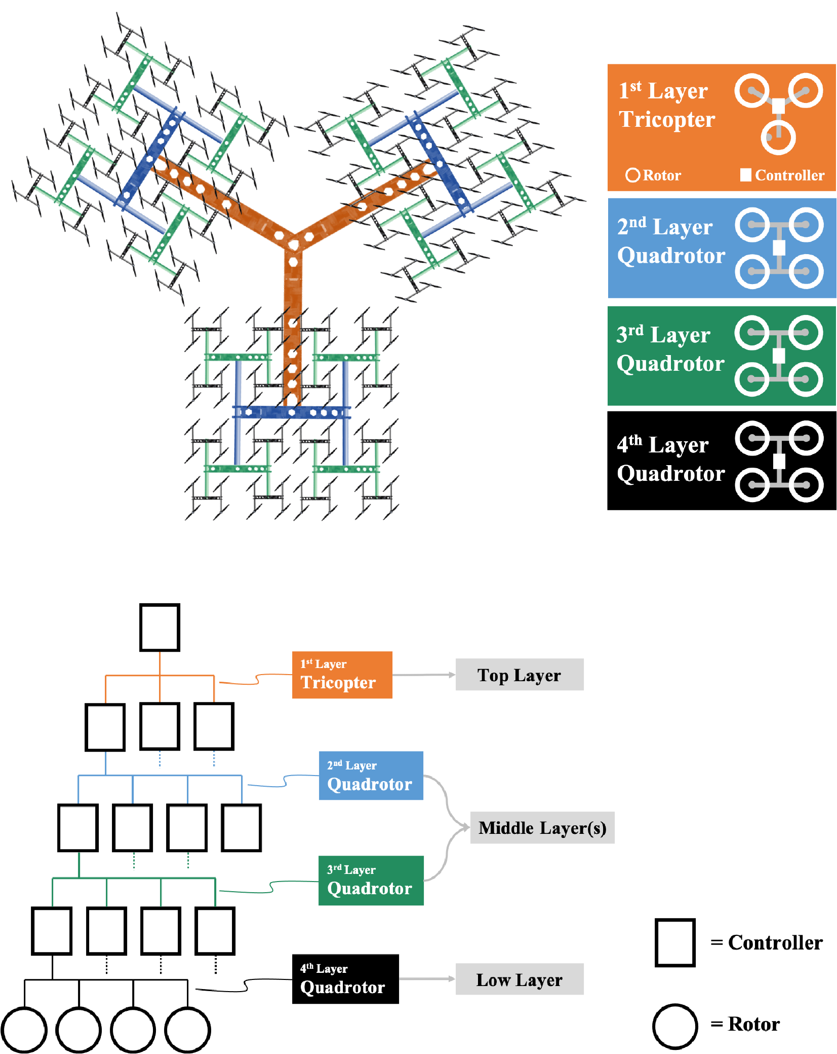
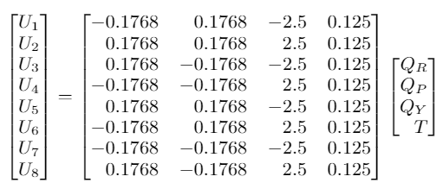

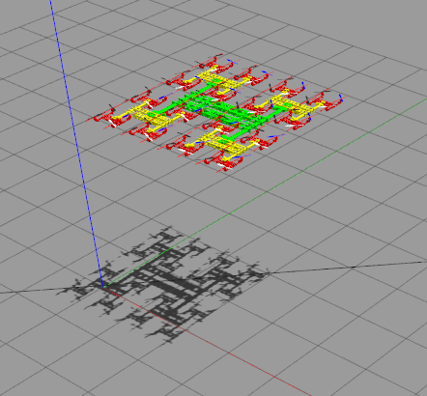
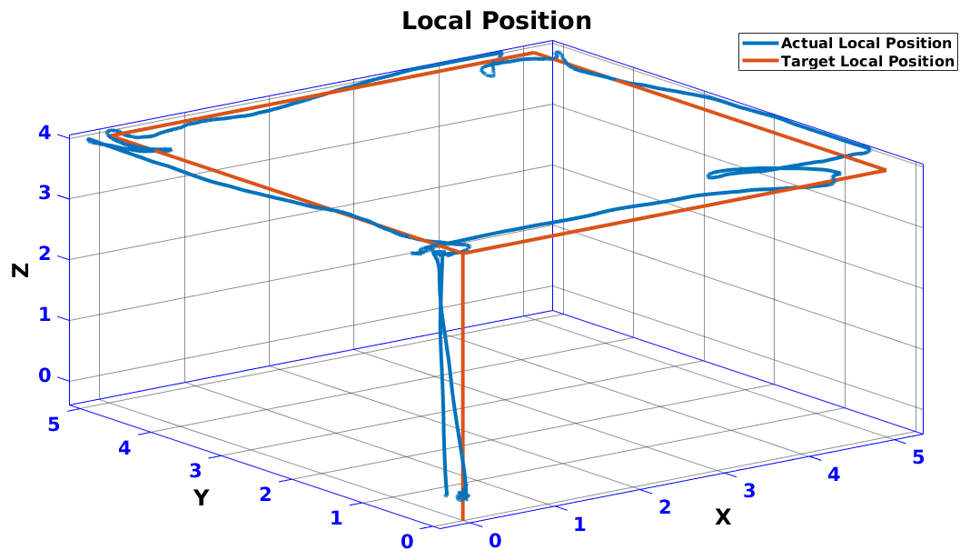
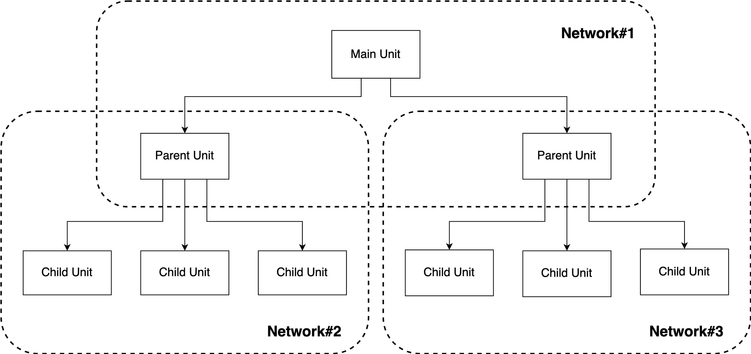
Multi-UAV Scalable Platform for Heavy Load Transportation
⚬ Pongsakorn SONGSUROJ Yoshito OKADA Kazunori OHNO Satoshi TADOKORO
4040
1. RESEARCH BACKGROUND
3. PLATFORM MODELLING
x
x
In lifting and transporting applications, the main design of a multicopter are a large propeller multicopter, and a small propeller multicopter. The table below shows advantages and disadvantages of both UAV types.
Our presented model consists of 3 layers.
1 unit at the top layer uses Quadrotor H airframe.
4 units at the middle layer use Quadrotor H airframe.
16 units at the low layer uses Quadrotor H airframe.
64 propellers are installed at low-layer UAVs
UAV Types | Large Propeller Multicopter | Small Propeller Multicopter
Safety | X | O
Redundancy | X | O
Stability | X | O
3-Layer Assembled UAV
Due to torque cancellation problem, this research purposes the idea to use coaxial airframe which is capable of providing double actuator outputs compared with a normal airframe.
It will allow propellers at each side to generate adjustable torque.
Thus, this research aims to provide scalability and reconfigurability for the UAV platform by combining multiple small propeller UAVs with multi-layer data transmission and centralized control methods.
2. METHODOLOGY
Octa-coaxial H Airframe
To calculate actuator outputs of the octa-coaxial H airframe, this research uses the pseudo-inverse method because the number of installed propellers is higher than degrees of freedom.
x
2.1 System Architecture
Control allocation Matrix of Octo-coaxial Airframe
Pseudoinverse Formula
Actuator output equation of Octo-coaxial Airframe
4. RESULT
Set the UAV model to move along a square trajectory in Gazebo simulated environment without wind and magnetic force acting on the UAV.
The 3D graph shows that the UAV model using this multi-layer platform can successfully follow the square waypoints.
Above figure shows that this platform separates UAVs into 3 layers, consisting of top layer, middle layers and low layer. Inside each layer, it supports several UAVs, except the top layer which contains one unit according to centralized control method.
Multi-UAV tested model in simulation
Actual and target local position
x
2.2 Data Transmission
5. CONCLUSION
In this research, we demonstrated the multi-UAV scalable platform with one main unit, four parent units, 16 child units with 64 propellers.
With this purposed method, the UAV platform can achieve stability and redundancy.
More UAVs can be installed to increase overall thrust and torque for higher payload.
Different types of airframe structures can be customized and reconfigured to match different work scenarios and increase functional diversity.
Only UAV units in the same network are allowed to communicate with each other.

